Slide 1



Consumer Goods Analytics
Presented by : Ahamed Buhari

Slide 2
Content
1. Company Overview 2. Problem statement 3. Dataset and model 4. Ad-hoc requests , output and insights 5. Recommendations

Slide 3





Company Overview
AtliQ Hardware is a company that sells computer hardware like PC, Mouse, printer, keyboard etc to different clients across the world.
They have major B2B business model.
AtliQ Hardware also has distributors in some countries with restricted trade. E.g. Neptune

Slide 4



Problem Statement
AtliQ Hardware faced a critical need for faster, data-informed
decision-making to remain competitive.
They sought to expand their analytics team by hiring junior
data analysts with strong technical and communication skills.
My Task
Reviewed ad-hoc-requests.pdf containing 10 business requests for
insights.
Wrote and executed SQL queries to address these requests.
Created a presentation for top-level management to showcase the insights.

Slide 5

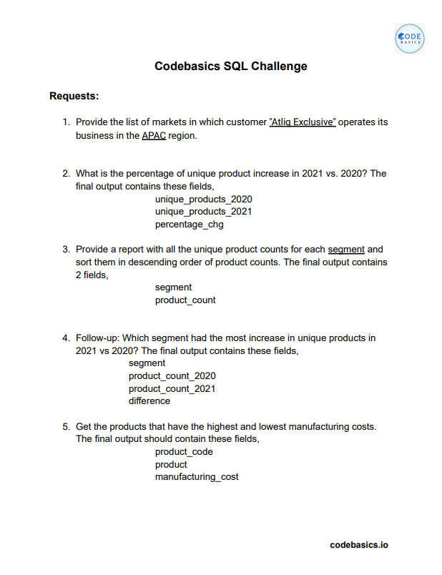
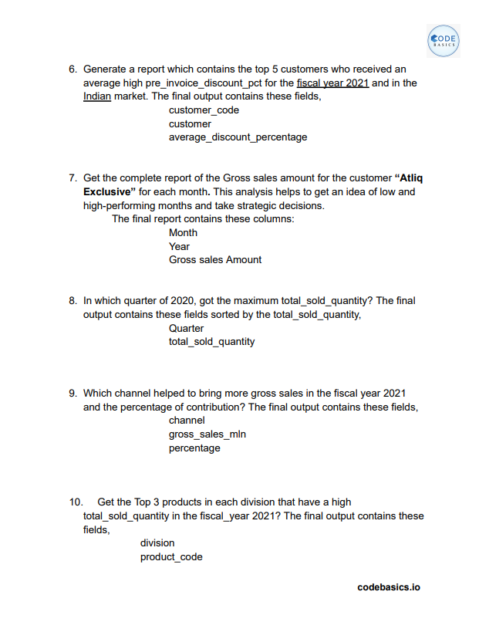

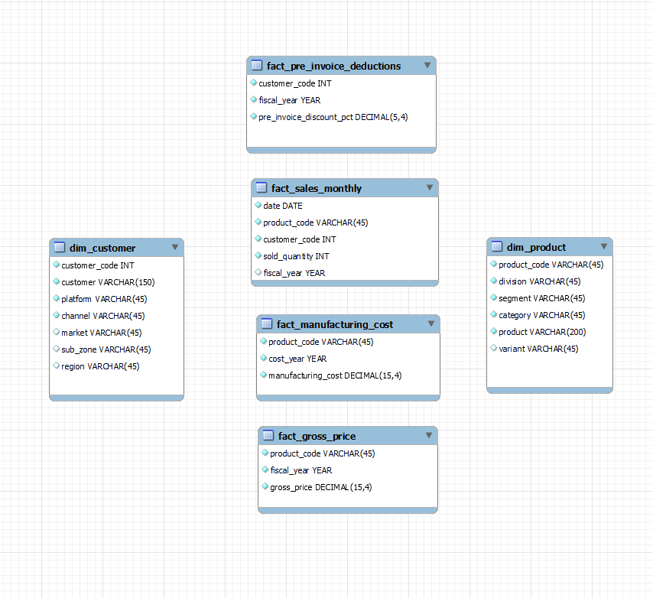
Dataset

Slide 6
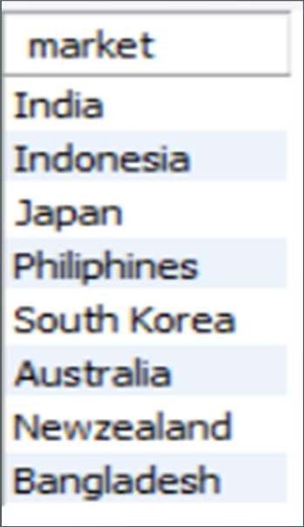
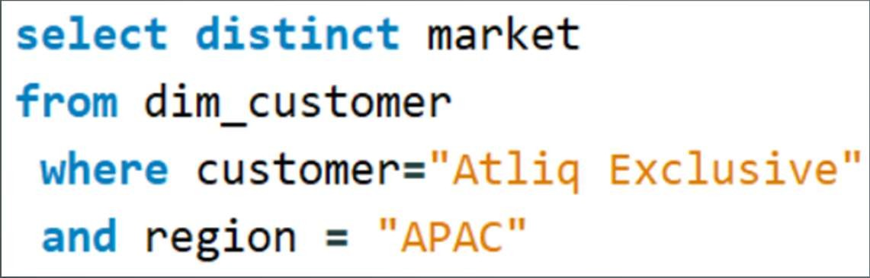
Ad-hoc requests , output and insights
Provide the list of markets in which customer "AtliQ Exclusive" operates its business in the APAC region.
Request 1
OUTPUT
INPUT

Slide 7
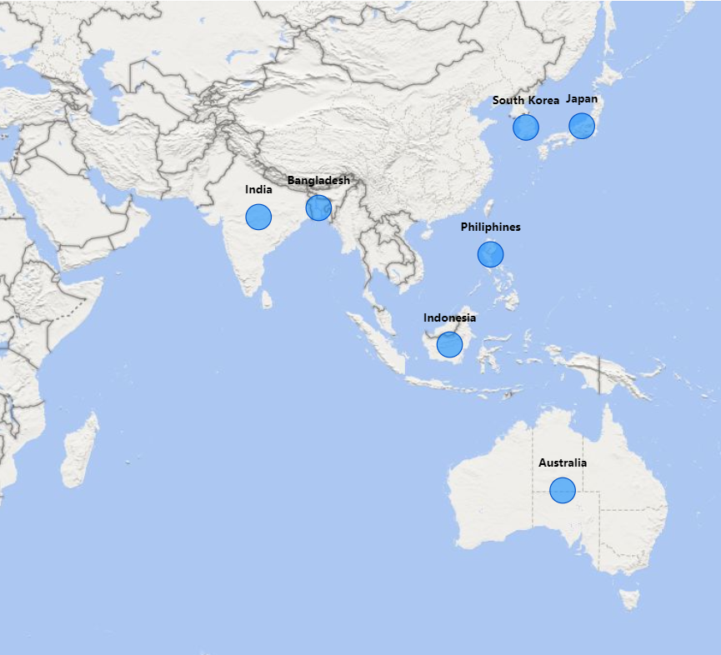
Insights
AtliQ Exclusive operates in eight countries within the APAC region, demonstrating a significant regional market presence.

Slide 8
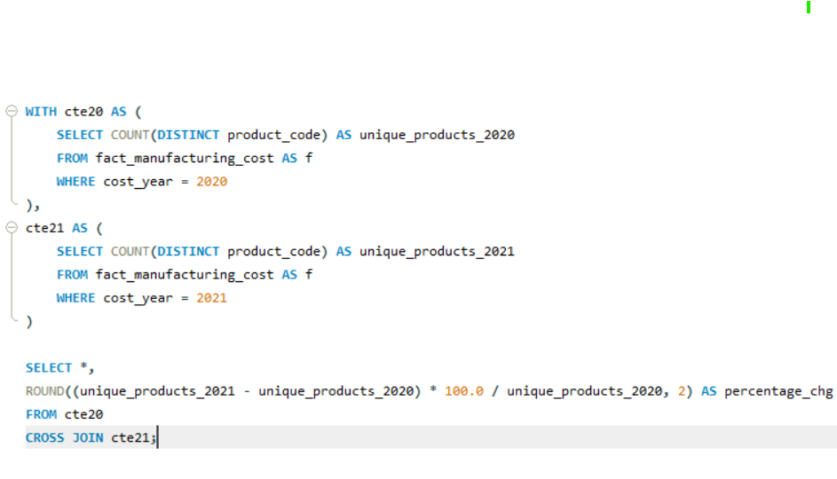
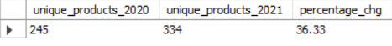
What is the percentage of unique product increase in 2021 vs. 2020? The final output contains these fields, unique_products_2020, unique_products_2021, percentage_chg .
Request 2
INPUT
OUTPUT

Slide 9
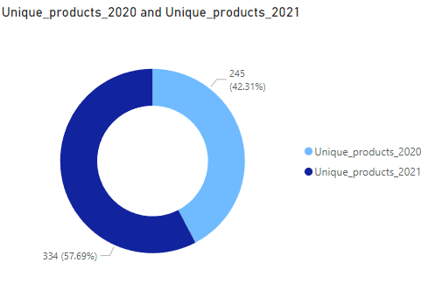
Insights
The number of unique products grew from 245 in 2020 to 334 in 2021, marking a 36.33% increase.
This significant increase highlights the company's commitment to innovation and meeting diverse customer needs.

Slide 10
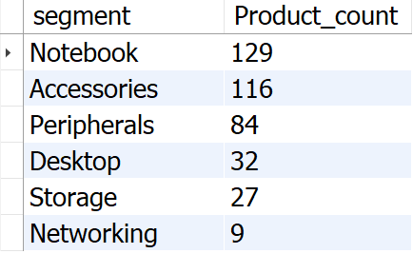
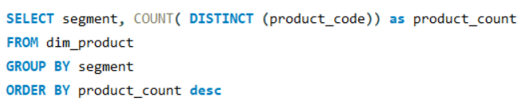
Request 3
Provide a report with all the unique product counts for each segment and sort them in descending order of product counts. The final output contains 2 fields, segment, product_count.
OUTPUT
INPUT

Slide 11
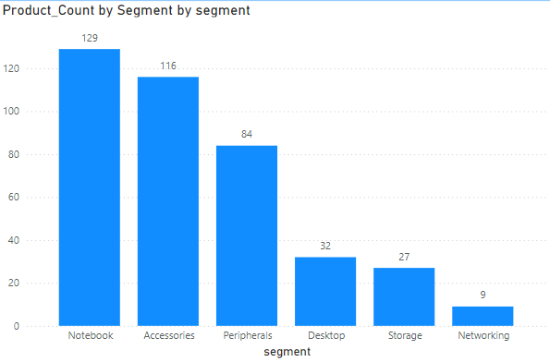
AtliQ shines in Notebooks, Accessories, and Peripherals segment, accounting for a whopping 82.87% of product variety.
Desktops, Storage, and Networking currently hold a minor share (17.13%) of AtliQ's product portfolio.
In Desktops, Storage, and Networking segment AtliQ should focus on products that align with current customer trends and industry demands.

Slide 12
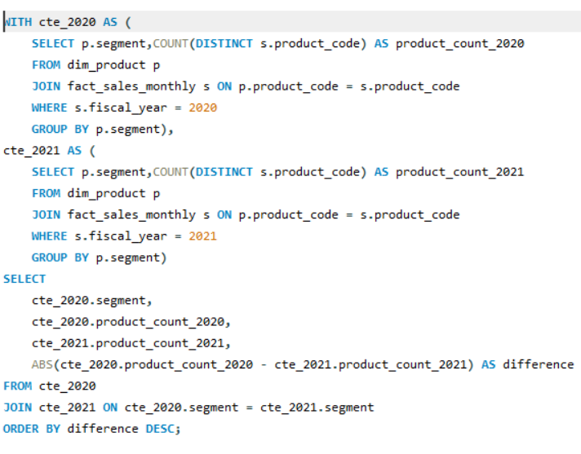
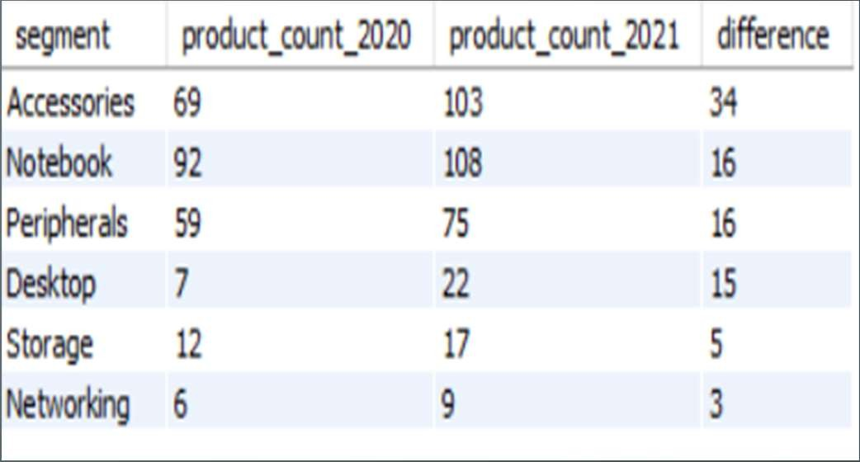
Request 4
Follow-up: Which segment had the most increase in unique products in 2021 vs 2020? The final output contains these fields, segment, product_count_2020, product_count_2021, difference.
INPUT
OUTPUT

Slide 13
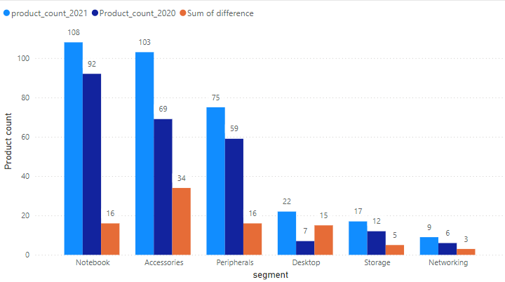
Insights
1. Accessories have the most increased products from 2020 to 2021, with an increase of 34 new products.
2. Desktop products production increased drastically by approximately 214% from 2020 to 2021.
3. Storage and Networking segments are producing the least new products from 2020 to 2021.

Slide 14
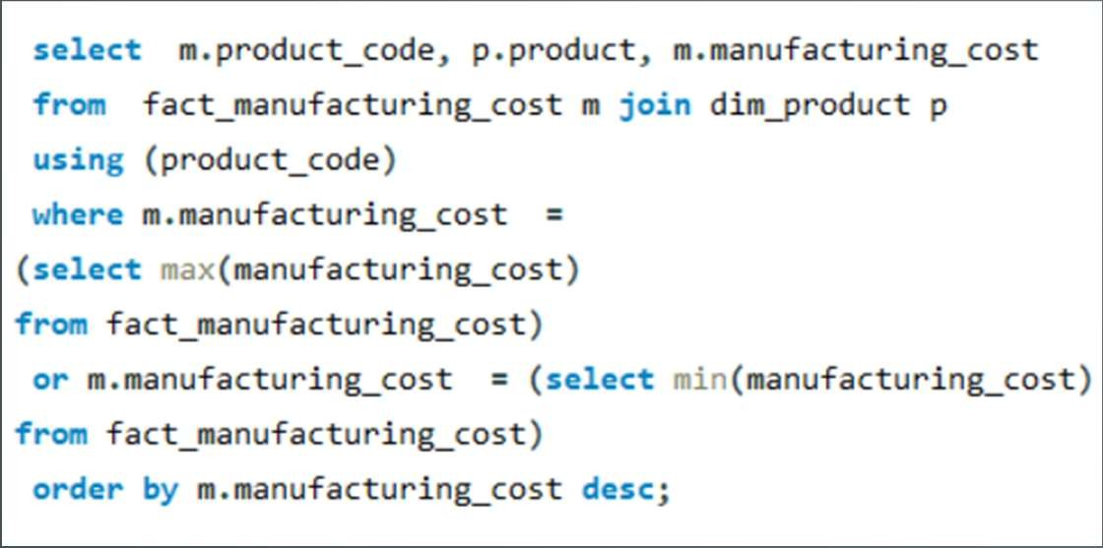
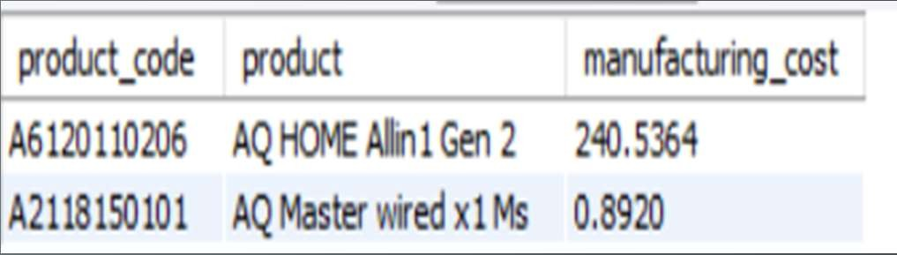
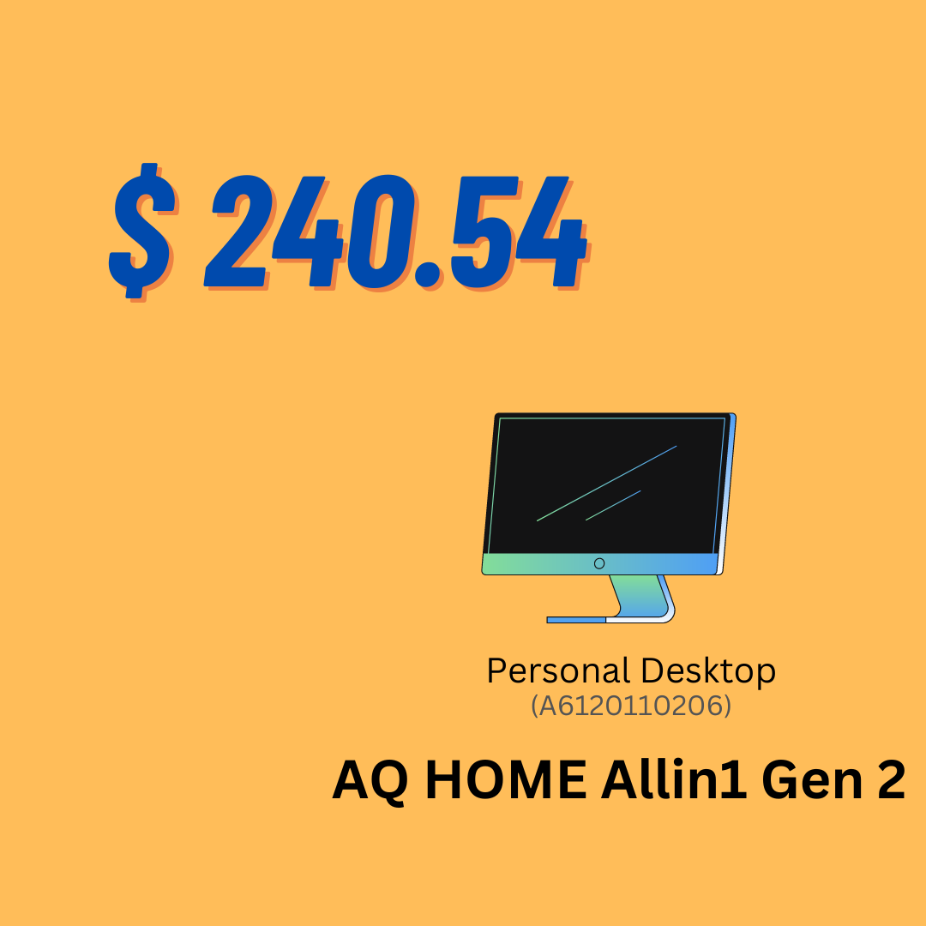
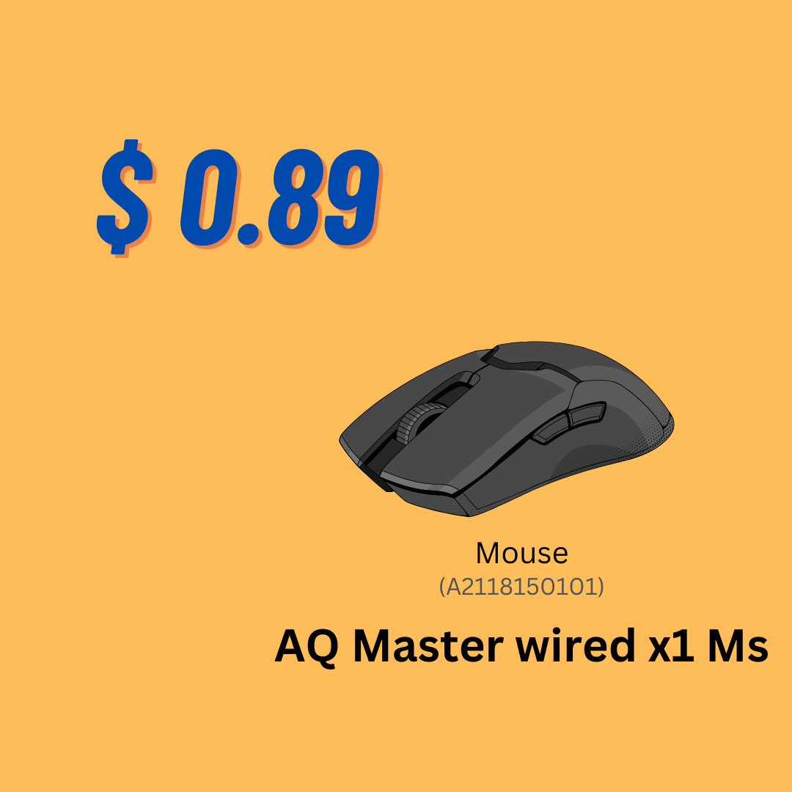
Request 5
Get the products that have the highest and lowest manufacturing costs. The final output should contain these fields, product_code ,product, manufacturing_cost .
INPUT
OUTPUT

Slide 15
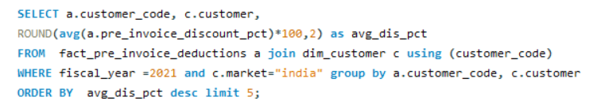
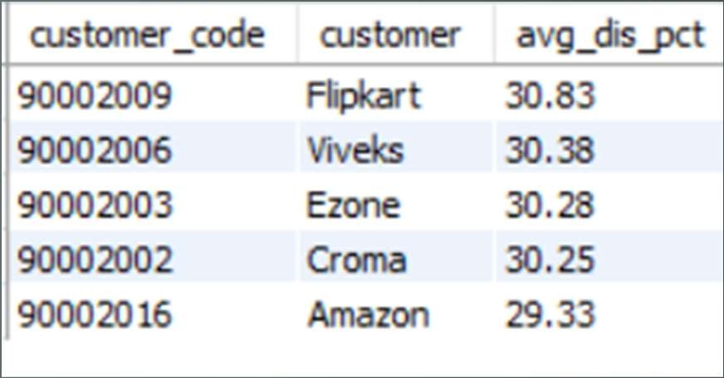
Request 6
Generate a report which contains the top 5 customers who received an average high pre_invoice_discount_pct for the fiscal year 2021 and in the Indian market. The final output contains these fields, customer_code, customer, average_discount_percentage .
INPUT
OUTPUT

Slide 16
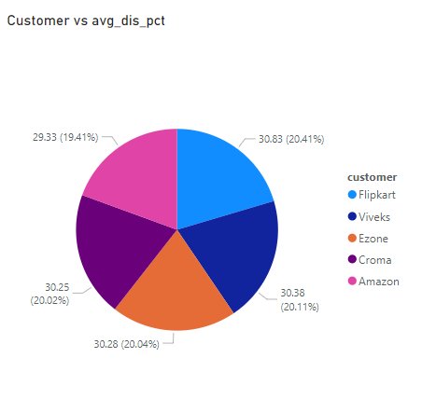
Insights
Flipkart leads the list with the highest average discount percentage at 30.83%
AtliQ has provided relatively uniform discount percentages to its top 5 customers, with a narrow range of discounts from 29.33% to 30.83%.
The minimal variation in discount percentages (only about a 1.5% difference from the lowest, Amazon, to the highest, Flipkart) suggests a highly competitive market where each retailer offers similar discounts to attract customer

Slide 17
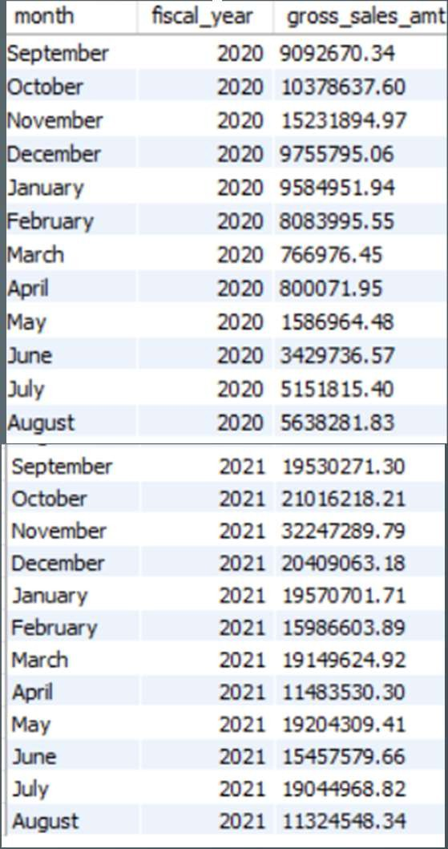
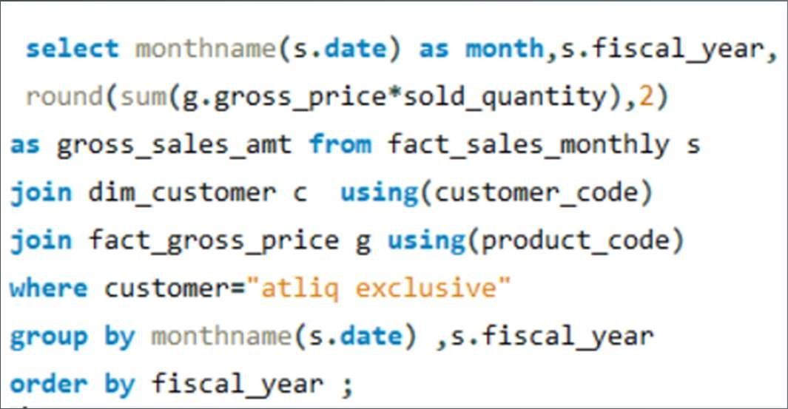
Request 7
Get the complete report of the Gross sales amount for the customer “AtliQ Exclusive” for each month. This analysis helps to get an idea of low and high-performing months and take strategic decisions. The final report contains these columns: Month, Year, Gross sales Amount.
INPUT
OUTPUT

Slide 18
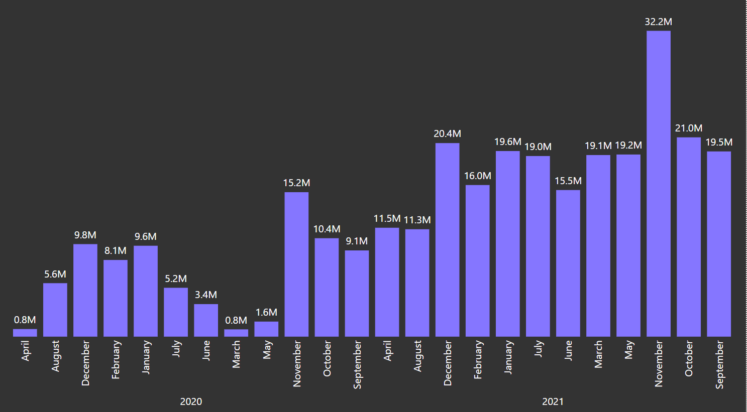
Insights
March, April, May recorded the lowest sales in 2020, likely due to the COVID-19 pandemic.
Sales began to recover after June 2020. November generated the highest sales for 2020, with around 15.23 million.
Sales figures in 2021 show significant growth compared to 2020.
In 2021, the lowest sales were in August, accounting for 11.32 million, while the highest sales were in November, reaching 32.25 million.

Slide 19
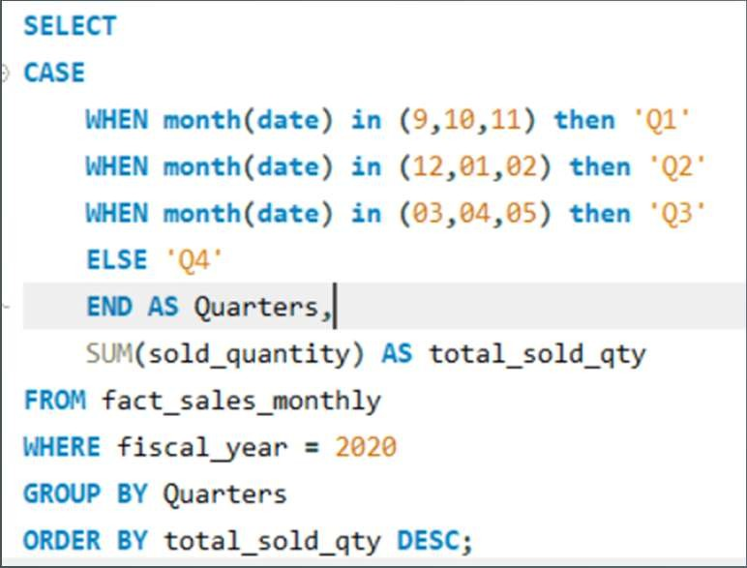
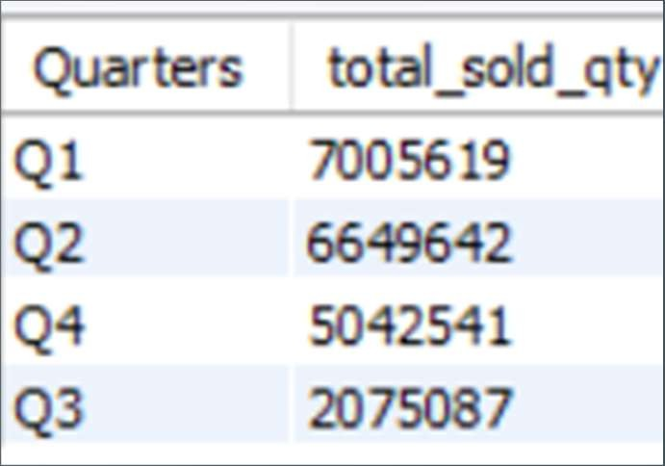
Request 8
In which quarter of 2020, got the maximum total_sold_quantity? The final output contains these fields sorted by the total_sold_quantity, Quarter, total_sold_quantity.
INPUT
OUTPUT

Slide 20
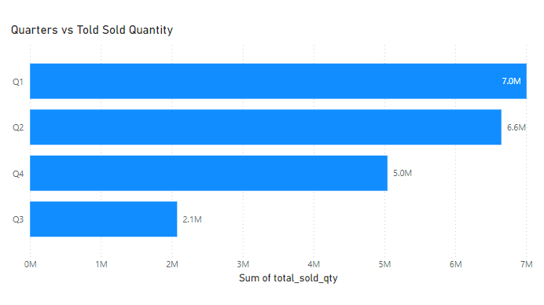
Insights
The highest total sold quantity is in Q1, with 7,005,619 units.
These insights highlight a seasonal variation in sales, with Q1 and Q2 being the strongest quarters and Q3 being the weakest.
This information is valuable for planning inventory and marketing strategies to align with seasonal demand.

Slide 21
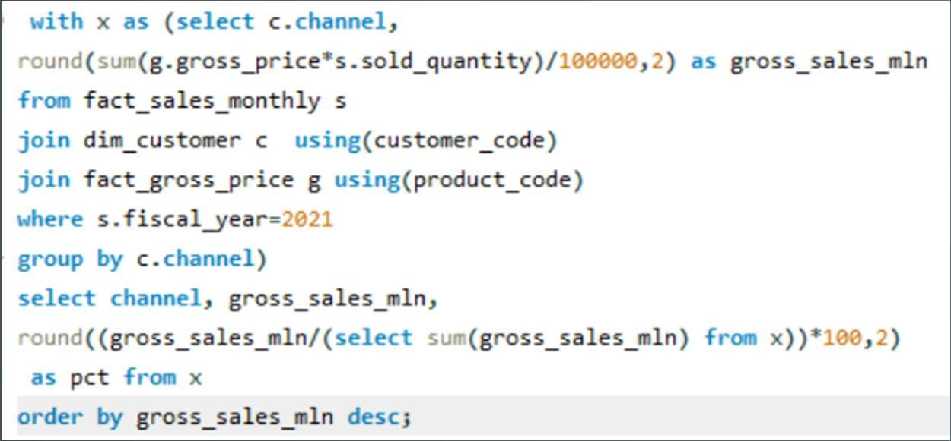
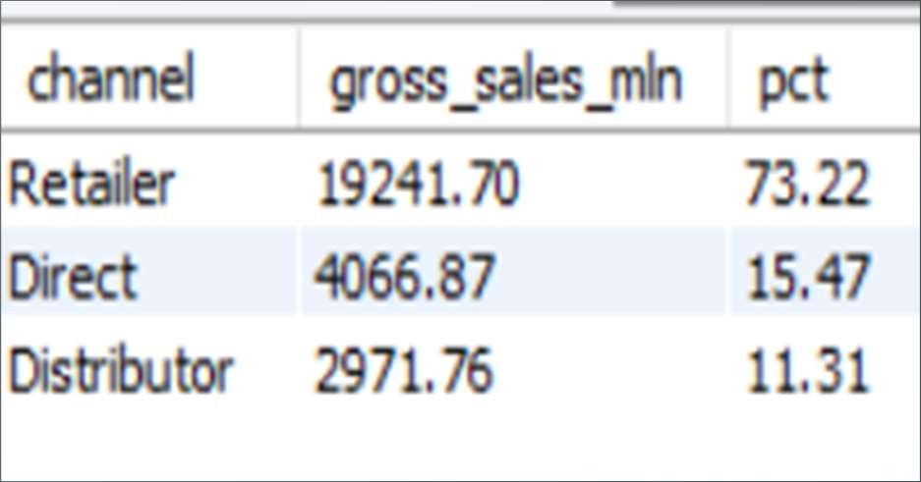
Request 10
Which channel helped to bring more gross sales in the fiscal year 2021 and the percentage of contribution? The final output contains these fields, channel, gross_sales_mln, percentage.
INPUT
OUTPUT

Slide 22
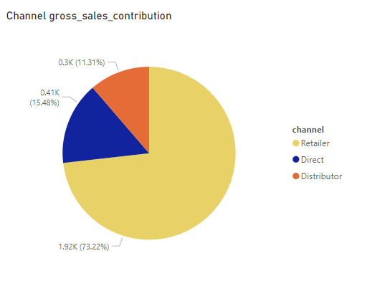
Insights
1. The majority of AtliQ's sales come from retailers, accounting for a substantial 73.22% of the total gross sales. 2. Direct and distributor channel together contributes only 26.79% of the total sales.

Slide 23


Recommendations
Revitalize Low-Performers: Drive growth in Desktop and Networking.
Seasonal Promotions: Implement discounts in low sales months (March-May, August)
Optimize Inventory: Stock high-demand products for Q1 and Q2; adjust in Q3.
Enhance Expand High-Selling Segments: Focus on Notebooks, Accessories, and Peripherals.
Loyalty Discounts: Offer exclusive rewards for high-value customers in India.

